Slide 1
Homework 1
Qunhao Zhang

Slide 2
Data Preprocessing
To gexf:
Read raw txt file use python.
Link each node in Networkx graph data structure.
Use networkx.write_gexf() to save gexf file.
To csv:
Read raw txt file use python.
Saperate each node number by ‘, ’.
Write to csv file.

Slide 3
Data Preprocessing(con.)
To gexf:
G = nx.Graph()
edges = read_txt_file(file_path)
for edge in edges:
G.add_edge(edge[0], edge[1])
nx.write_gexf(G, target_path)
To csv:
edges = []
for line in source_file:
edges.append(line.split('\t'))
for edge in edges:
target.write(edge[0] + ',' + edge[1])

Slide 4
Networkx
Networkx is a python library for analyzing complex networks.
It provides useful algorithms and data structures.
You can use:
import networkx as nx
to start using networkx.
Let compute a diameter for example!

Slide 5
Diameter
Creating graph
G = nx.Graph() #initialize our data structure
for line in open('hw1/HepTh.txt', 'r'): #line : 3466 937
ids = line.split() # ids = ['3466', '937']
G.add_edge( int(ids[0]), int(ids[1]) )
#ids are strings, but add_edge wants integers.
#make sure to convert them

Slide 6
Diameter(con.)
We want simply:
nx.diameter(G)
but not working......
Because the graph is divided into parts.

Slide 7

Diameter(con.)
Solution:
print("Diameter of the graph:",
max([nx.diameter(G.subgraph(subGraph))
for subGraph in list(nx.connected_components(G))]))

Slide 8
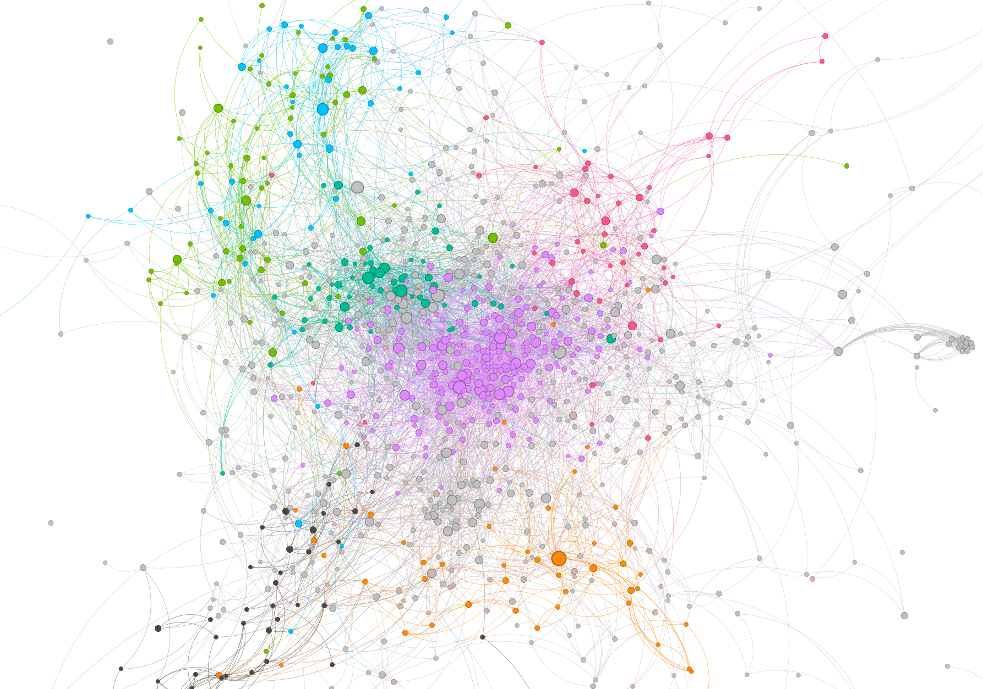
Visualization
Using Gephi
Choose a layout to expand nodes.
In statistics, run the Average
Degree, Modularity.
Color by Modularity,
size nodes degree.

Slide 9
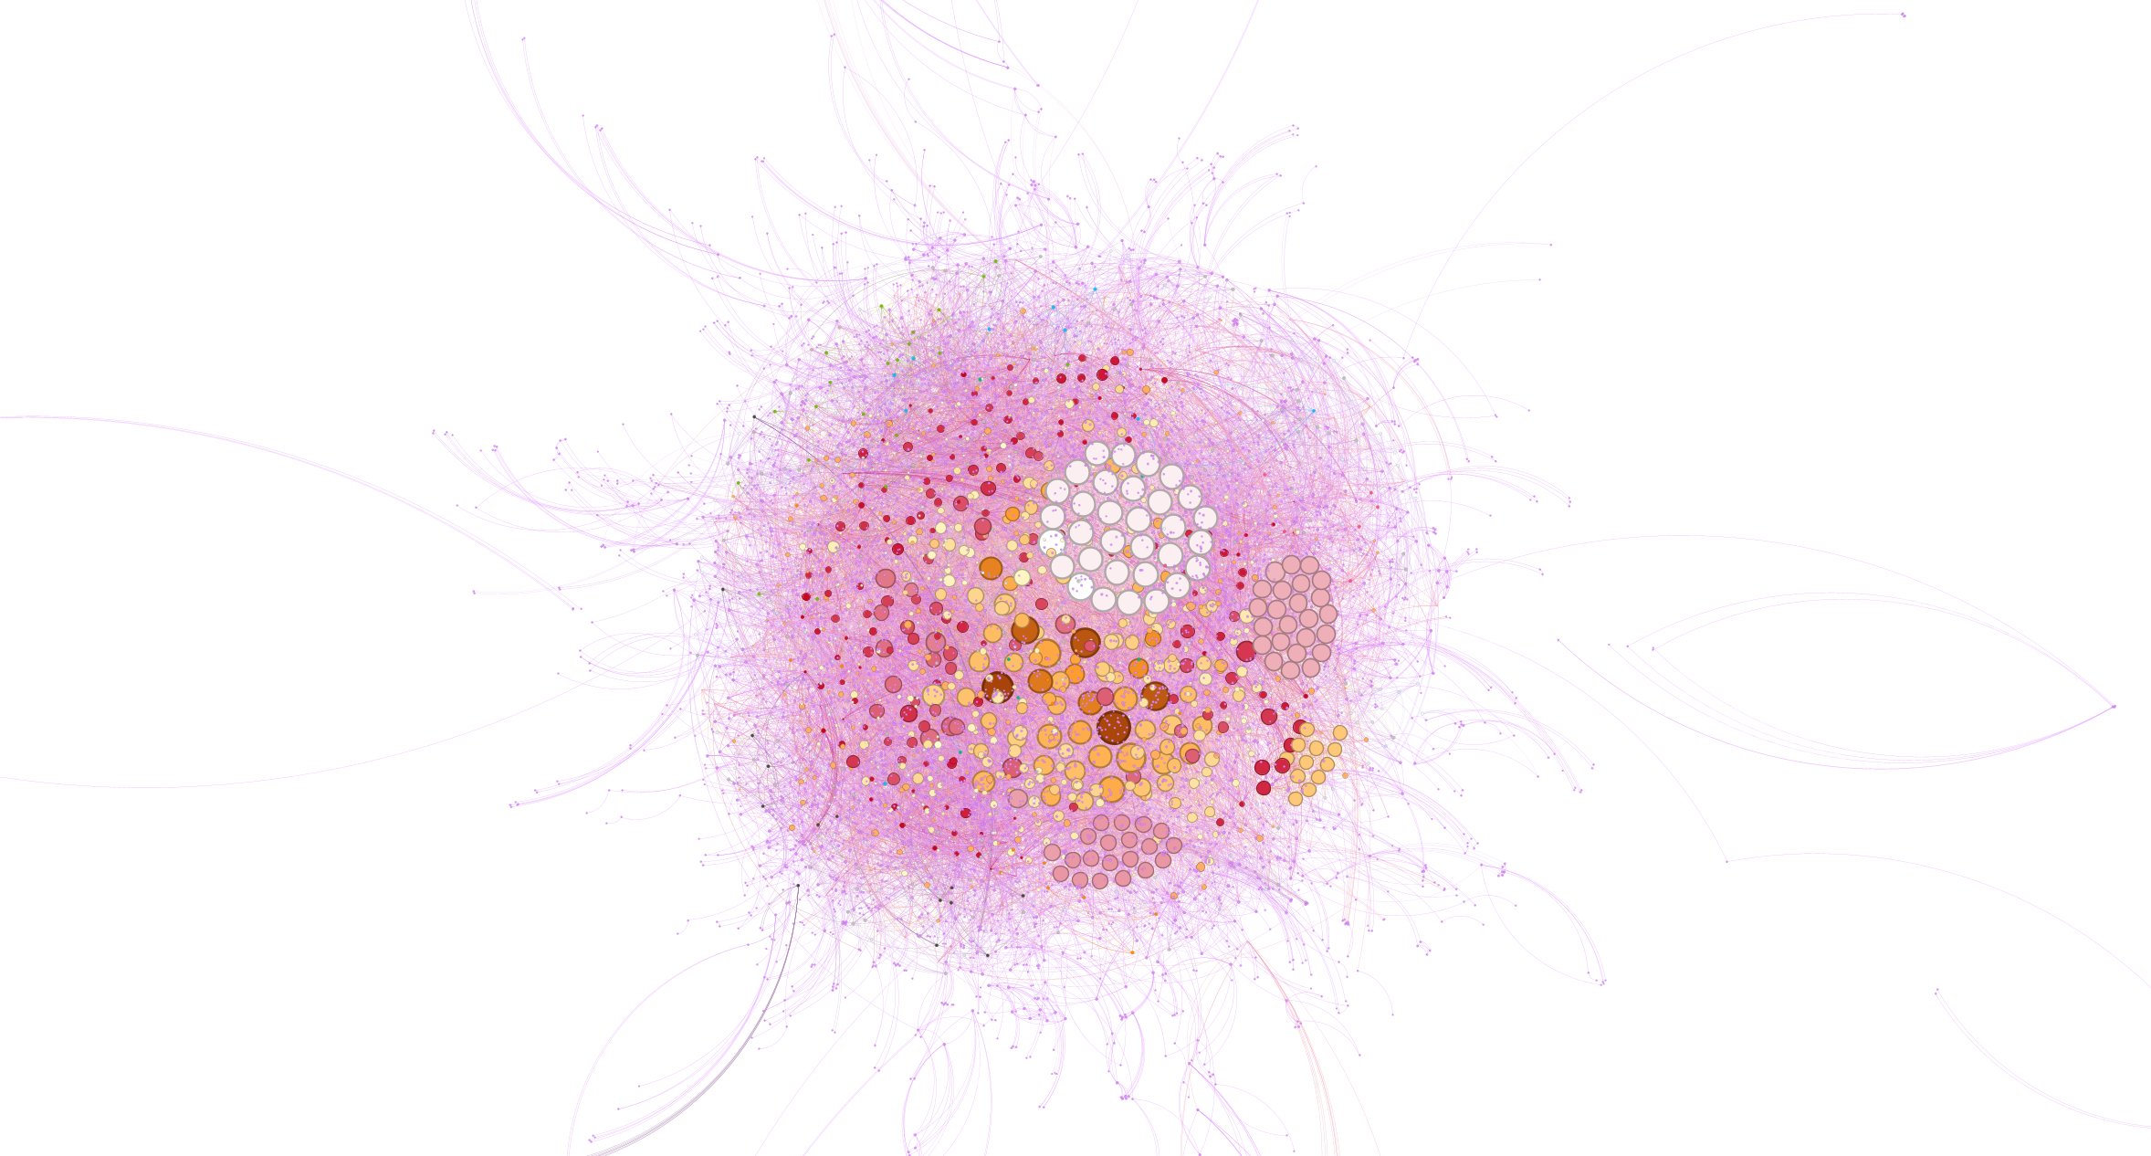
Use Fruchterman Reingold layout

Slide 10
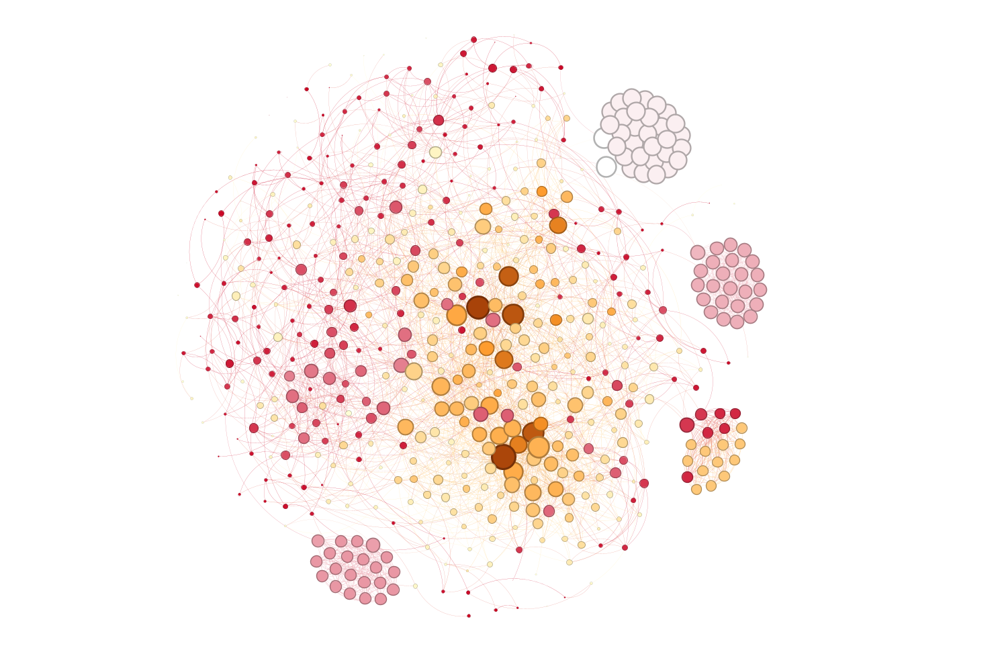
Filter a bit

Slide 11
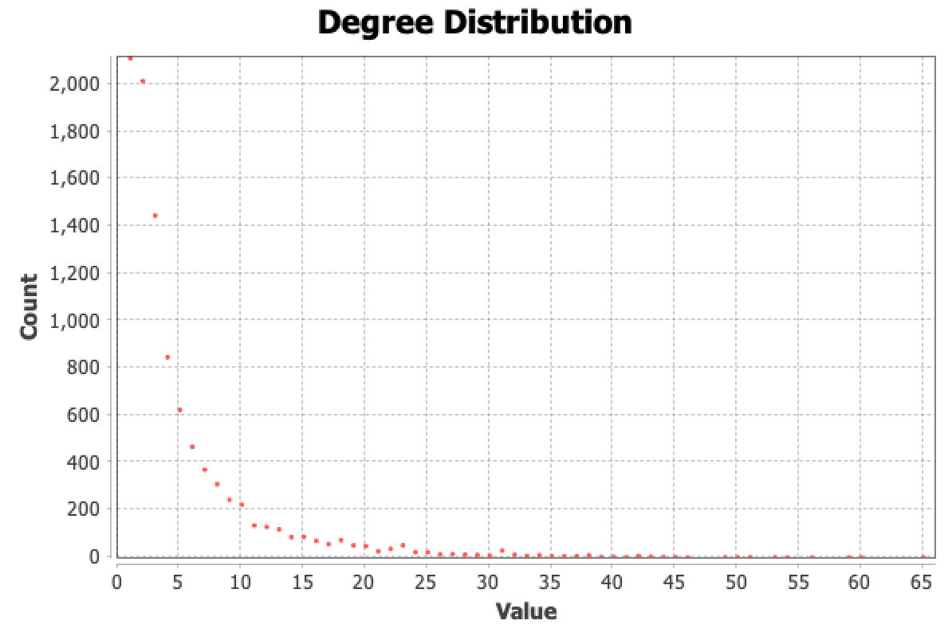
Degree distribution shows how many nodes of a certain degree.

Slide 12
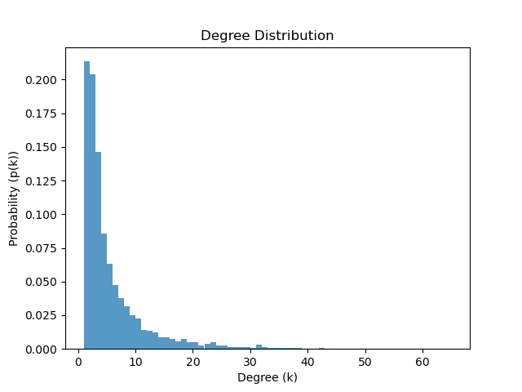
p(k) is the probability of a random chosen node has degree k.

